Slide 1
Applying the
IEEE Template to a Presentation
Prepared by the Staff Learning Center

Slide 2

Table of Contents:
Downloading the IEEE template ……………Slide 3
Applying the template to an existing presentation…………………………………………… Slide 4
Saving the template in Themes toolbar…Slide 6
Applying custom title slide background…Slide 7
Troubleshooting formatting issues…………Slide 11

Slide 3
Downloading the IEEE Template
From the Web page, click the link for the IEEE presentation template and save the template to your computer
  Suggestion: Under your My Documents folder, create a folder called Presentation Template and save the template there

Slide 4

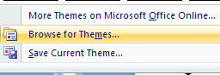
Applying the IEEE Template to an Existing Presentation (1 of 2)
Have existing presentation open
Select the Design tab in PowerPoint
Choose the bottom arrow on the left side of the slide graphics in the Themes group
Once the menu has opened, select Browse for Themes
Choose bottom arrow

Slide 5
Applying the IEEE Template to an Existing Presentation (2 of 2)
Find the IEEE presentation template that you saved
Select the IEEE presentation template and click Apply
The IEEE presentation template is applied

Slide 6
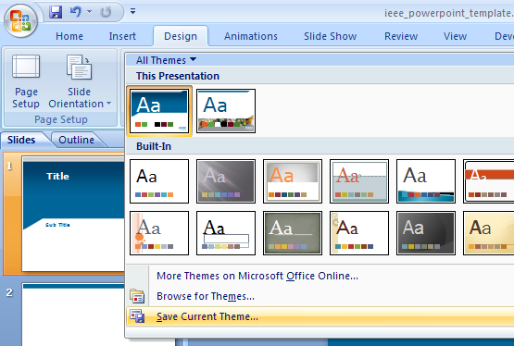


Saving the IEEE Presentation Template in “Themes” for Easy Access
  Once the IEEE presentation template is applied, click again on the themes arrow and select Save Current Theme
  Name the theme (IEEE PowerPoint) and click Save
  The IEEE presentation template will be saved in your themes bar

Slide 7
Applying Custom Title Slide Backgrounds
to an Existing Title Slide

Slide 8
Applying the Custom Layout to a Selected Title Slide
There are three different graphic themes that may be applied to a title slide
  historical images
  images of users
  technology images
Right click the slide you wish to change
  Choose Layout (screenshot on next slide)
  Apply the appropriate custom layout that you wish (under IEEE customslides)–you may have to scroll down to find them. (see screenshot on next slide)

Slide 9
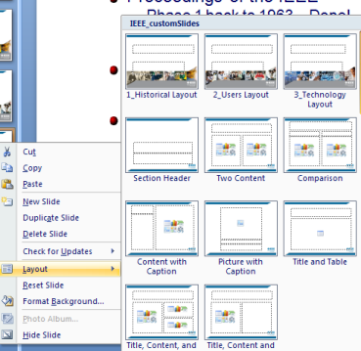
Applying the Custom Layout to the Selected Title Slide

Slide 10

Applying the Custom Layout to the Selected Title Slide
The layout was applied to the slide. This can be done with any layout available in the IEEE template.

Slide 11
Troubleshooting
Formatting Issues

Slide 12
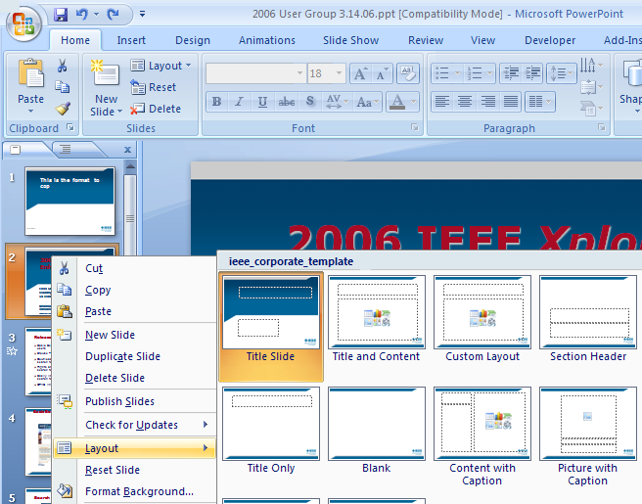
1. Using the Layout Function to
Re-apply the IEEE Template Format
You may need to
re-apply the slide Layout on presentations created in an older version of Power Point.
  Right click on a slide that needs updating and choose Layout from the pop up
  menu.

Slide 13
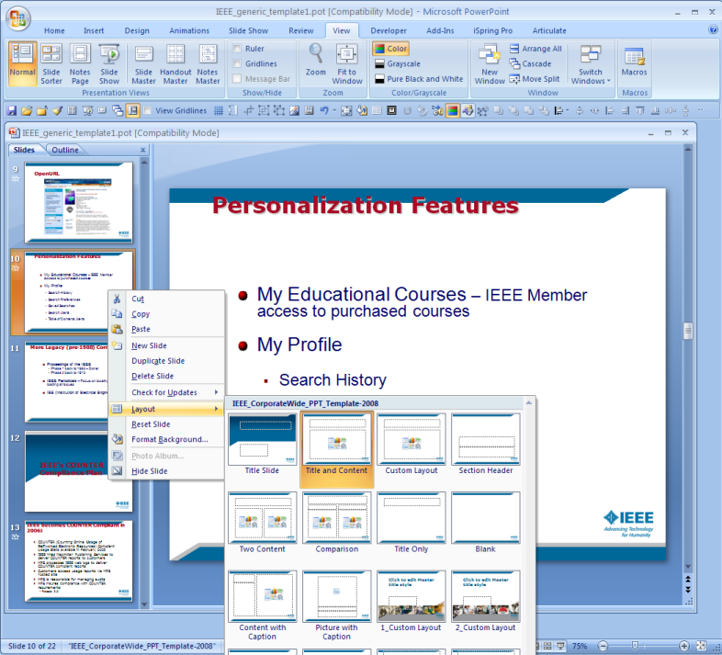
Repeat the Same Process to Correct Subhead & Text Position

Slide 14
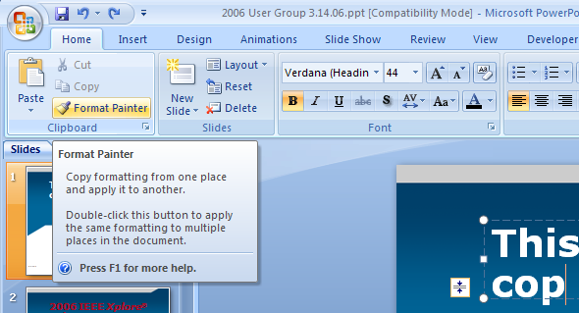
2. Using the Format Painter Icon to Copy Formatting

Slide 15
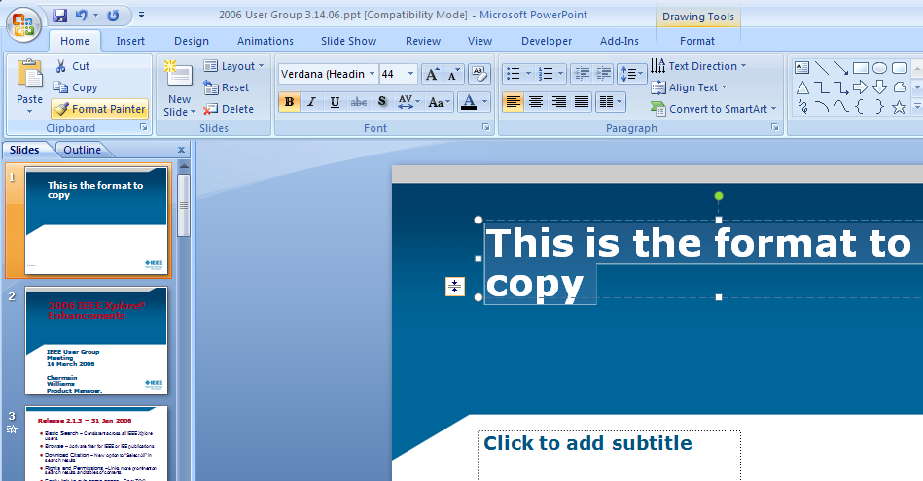
Insert a New Slide as a Sample to Copy the Correct Format
Highlight the
text in the sample of the format to copy. (1)
Click the Format Painter brush icon in the upper left of the Home tab. (2)
2
1

Slide 16
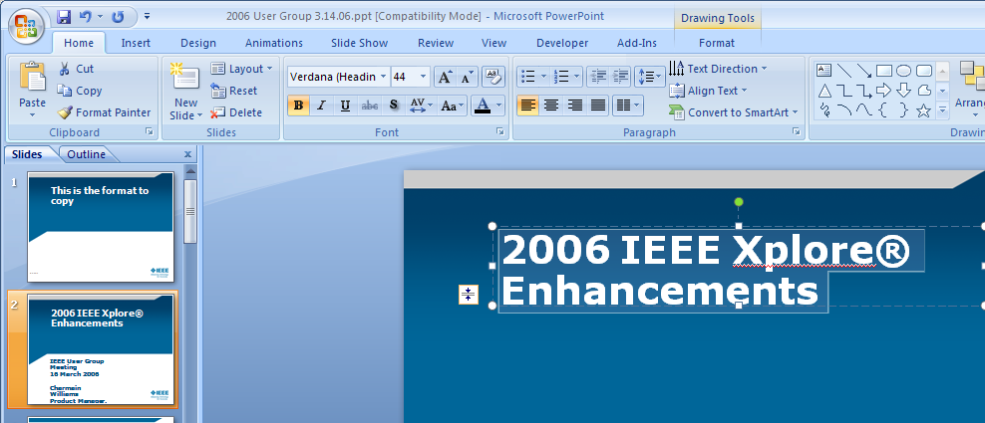
Apply the Font Style to the Text You Want to Update
With the “style” loaded in the Format Painter brush icon, drag the paint brush over the text of the font style to update. (3)
3

Slide 17
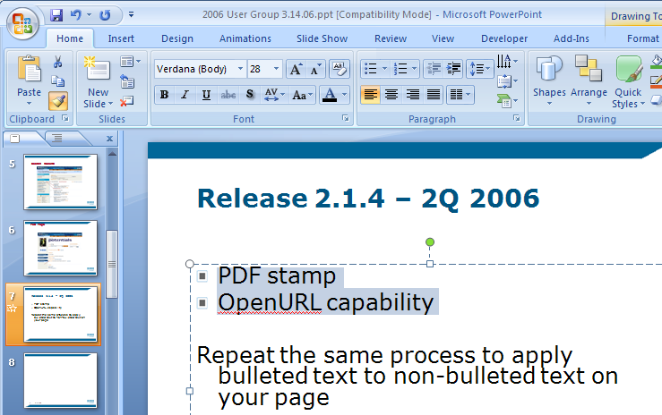
Repeat the Same Process to
Re-apply the Custom Bullet
Highlight the text in the bulleted list.
Click the Format Painter brush icon, then drag the “style” loaded paint brush over the non-bulleted text.

Slide 18
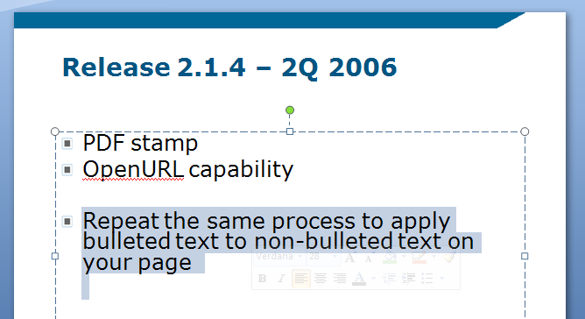
Repeat the Same Process to
Re-apply the Custom Bullet

Slide 19
For Further Assistance
Need more information on using
Microsoft PowerPoint 2007?
Visit the Staff Learning Center Calendar
and Course list at:
Staff Learning Center Courses
or get some quick help at
Up to speed with PowerPoint 2007_x000b_

